Slide 1
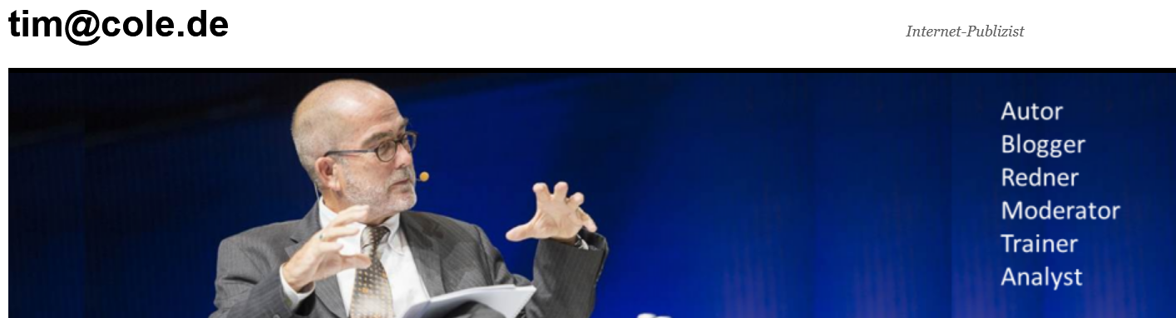
The Future of Making
Making the Future
Notes:
Hi, I‘m Tim Cole. People sometimes call me an Internet Veteran, which gives you a rough idea of how old I am, but I still feel comfortable among the younger Internet startup set, even though many of them weren‘t even born when I started my blog as far back as 1995. I am a compulsive author of books about digitalization and the Internet; in fact, I have written a round dozen of them over the past two decades. I have also hosted TV show, moderated radio panels, and of course given hundreds of talks like this one, both in person and today, sadly, only virtually, but at least I have already got my covid shots, so there‘s hope we will maybe see each other at some event in the not all too distant future.

Slide 2
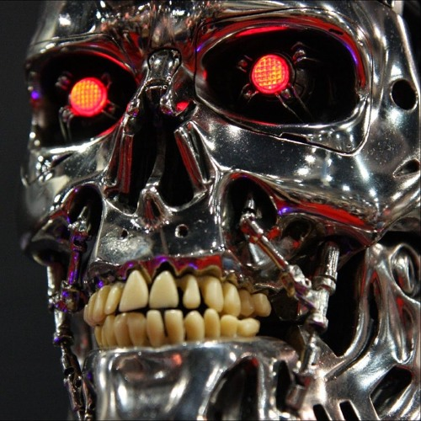
Who‘s afraid of Artificial Intelligence?
Notes:
The future of making stuff is closely linked to the rise of artificial intelligence, which has been defined as ”the capacity given by humans to machines to memorize and learn from experience, to think and create, to speak, to judge and make decisions.”
Unfortunately, many people are still afraid of artificial intelligence. They fear that robots will take away their jobs and new technologies will lead to a total surveillance state.

Slide 3
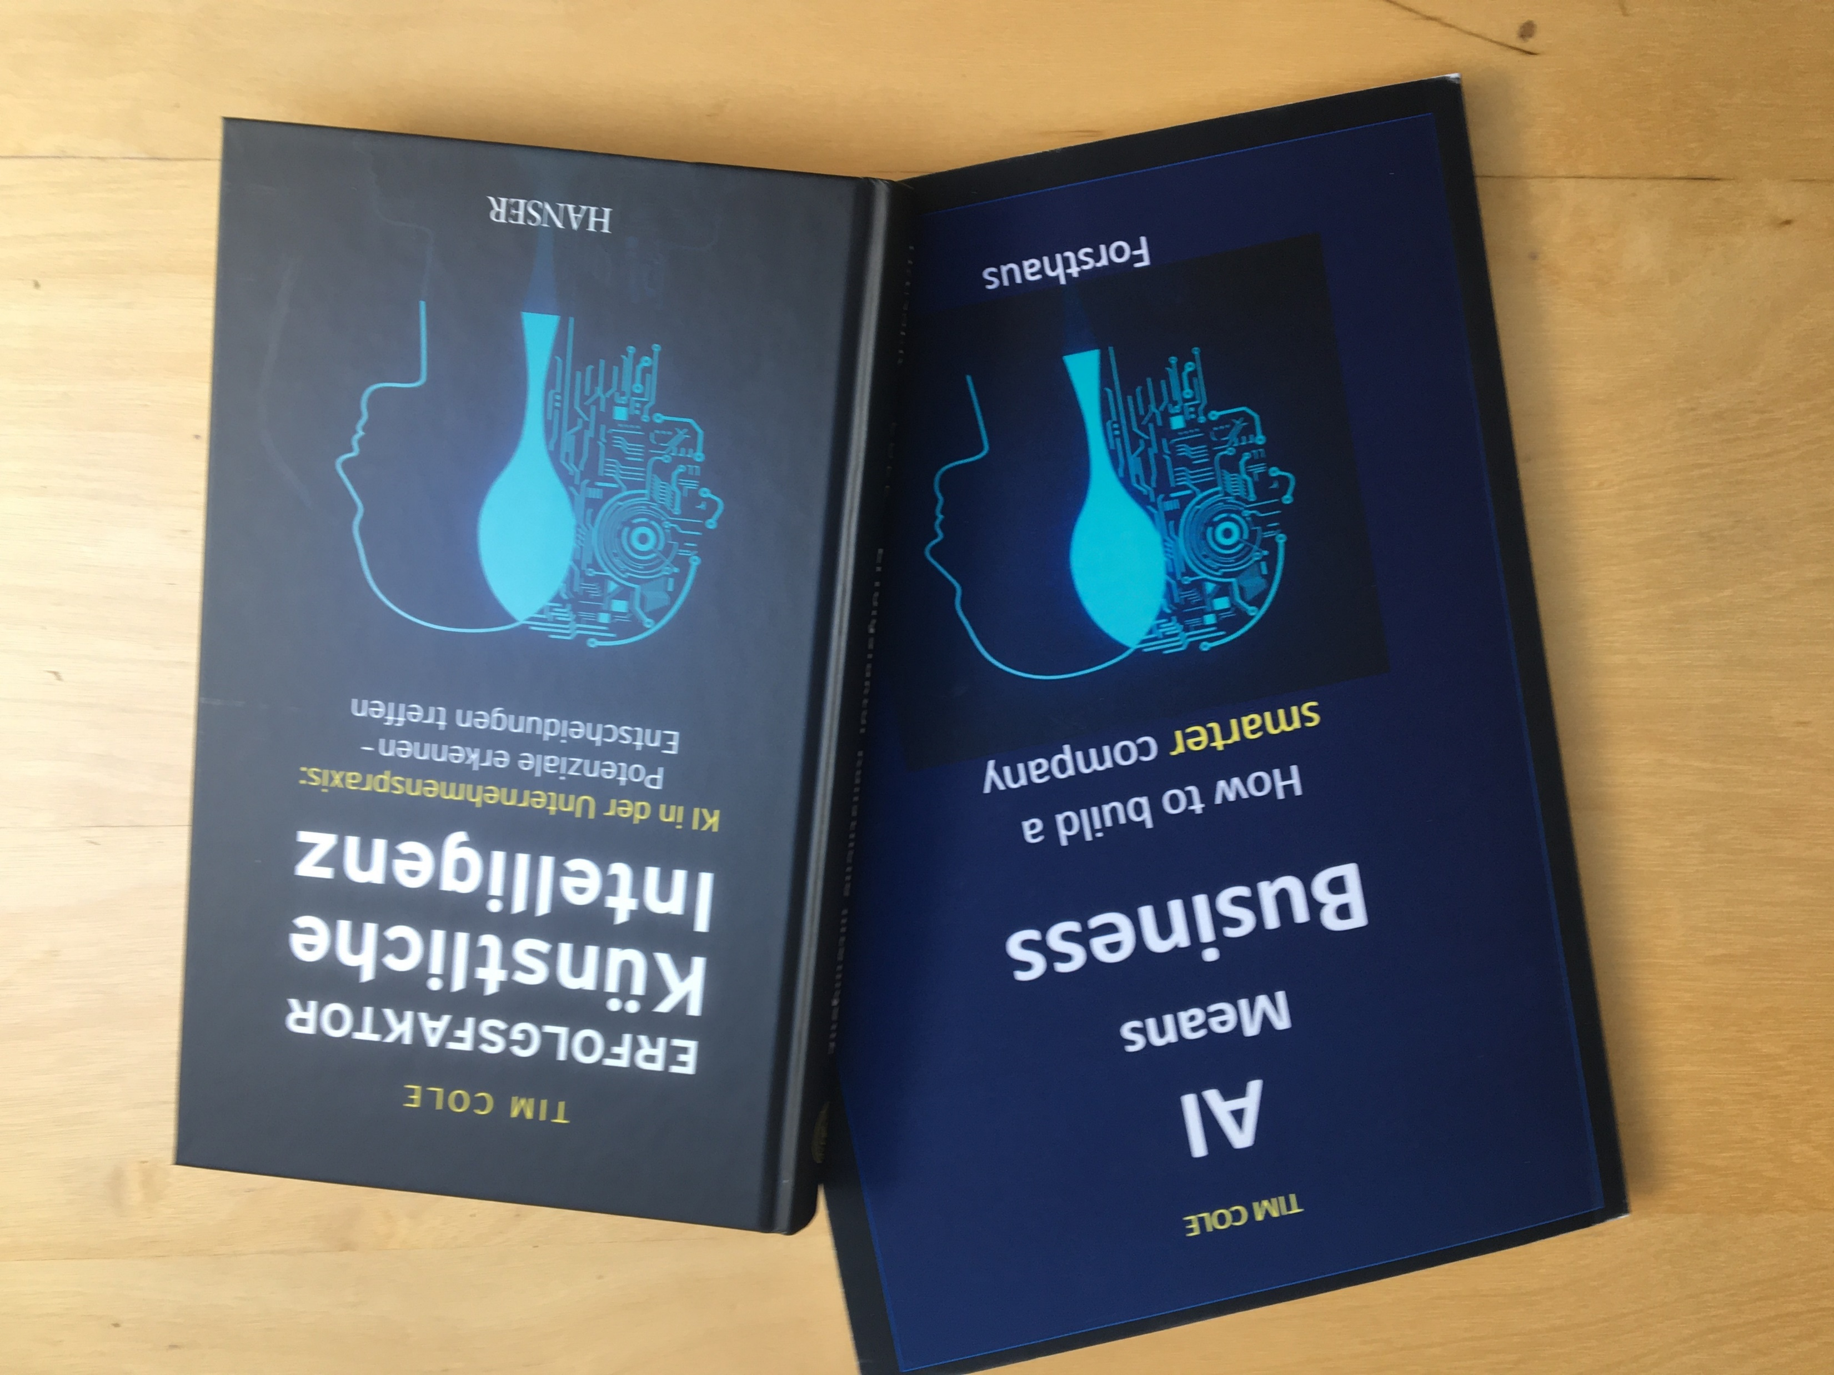
Notes:
In fact, these fears are justified: If we as a society are not careful and let AI fall into the wrong hands, even those worst nightmares will be surpassed.
In my latest book, Success Factor Artificial Intelligence, which is also available in English on Amazon as AI Means Business, I try to allay their fears and show how AI can be used by businesses meaningfully and profitably and enrichen the lives of everyone.

Slide 4
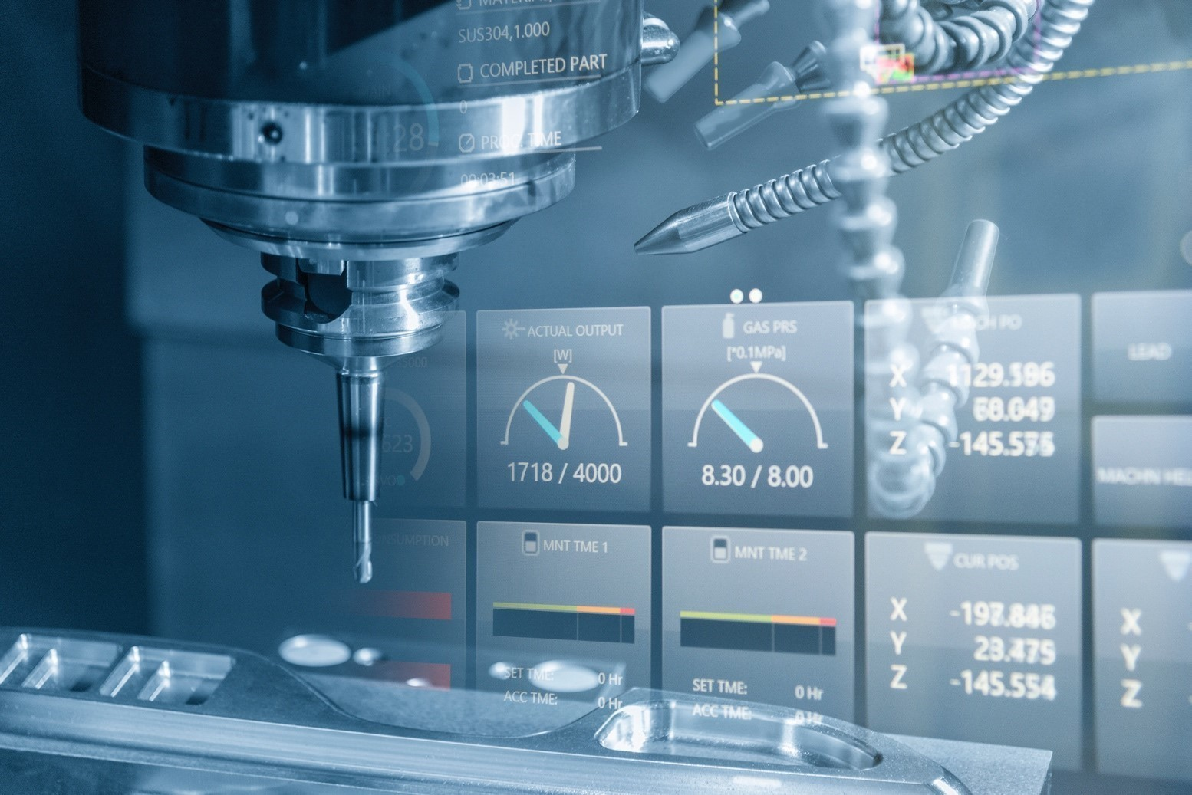
Manufacturing Data
Notes:
Today, everbody‘s talking about the Smart Factory where everything is automated and the costs of manufacturing are steadily falling.
But it‘s important to realize that the Smart Factory produces one thing above all else, namely information – data – the new crude oil of the twentyfirst century!

Slide 5
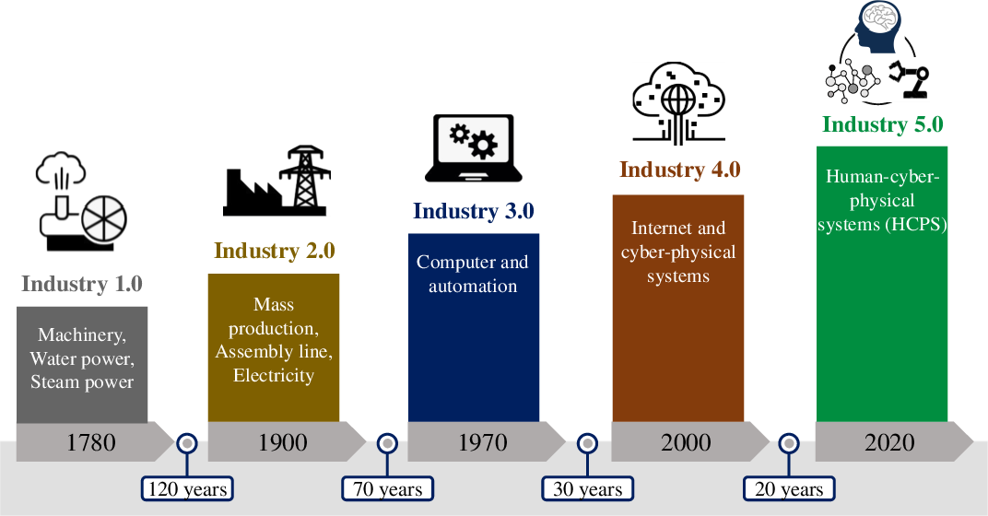
Where are we today?
Notes:
In this context, it helps to look back on the history of manufacturing.
It all began with the first industrial revolution, or what most historians refer to as simply “The Industrial Revolution.” This was when the primary means of manufacturing moved from manpower to machine power.
Fuel sources like steam and coal made machine use more feasible, and the idea of manufacturing with machines quickly spread. They were faster and made all kinds of new innovations and technologies possible as well.

Slide 6
Where are we today?
Notes:
The Second Industrial Revolution, sometimes called “The Technological Revolution,” brought more new sources of power such as electricity which led to sophisticated new machines and new methods of making things such as mass production.

Slide 7
Where are we today?
Notes:
Although we usually don’t think of the 1950s as the period in which our world turned digital, it was here where the digital revolution began with the first computers. They were often very simple, unwieldy and incredibly large compared to today’s computers, but they laid the groundwork everything from punchcards to the Internet.

Slide 8
Where are we today?
Notes:
So that brings us to Industry 4.0, a term first coined in 2011 at the Hannover Trade Fair by Bosch. It is characterized by a new level of automation, where machines can often largely govern themselves, often by using internet technologies, or “the Internet of things.” Other features of Industry 4.0 include the use of cloud technology and the importance of big data.

Slide 9
Where are we heading?
Notes:
Today, we stand on the threshhold of what some experts are already calling „Industry 5.0“, or the „Man-Machine Revolution“. The term refers to people working alongside robots and smart machines. It’s about robots helping humans work better and faster. It adds a personal touch to the pillars of Industry 4.0, namely automation and efficiency.

Slide 10
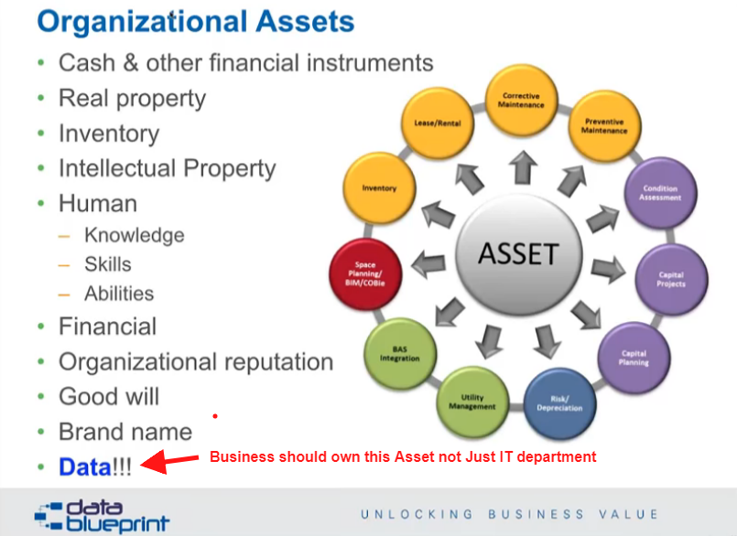
Notes:
Data, as we have already heard, lies at the center of both Smart Factories and Artificial Intelligence. Data are increasingly understood as an asset, like machines, buildings, trucks and cars.

Slide 11

Notes:
Data can take many forms, all of them critical to the success of a company. Siemens CEO Manfred von Pierer famously once sighed at a press conference: „If Siemens knew what Siemens knows, our numbers would be better.“

Slide 12
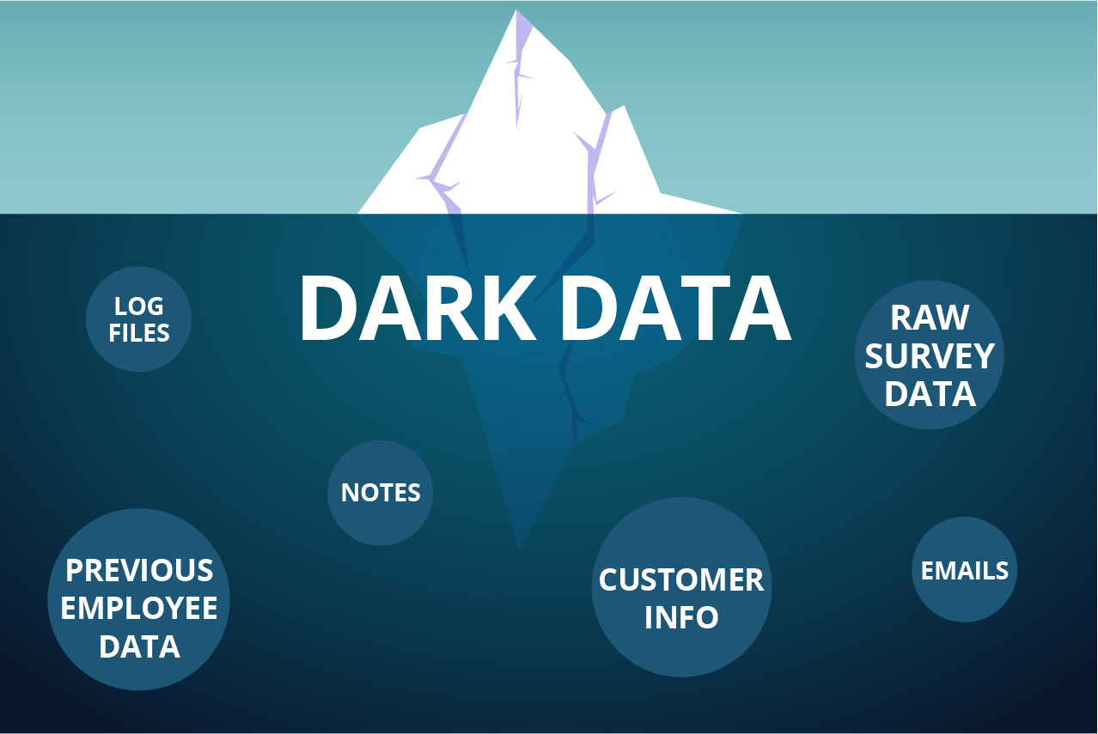
What we don‘t know can hurt us
Notes:
Some data is digital and therefore easily searchable through databases. Unfortunately, there are other forms of data that, while equally important, aren‘t available in digital form or at least not in a searchable one – things like e-mails, notes, log files or previous employee data.
These constitute what AI people call „dark data“.

Slide 13
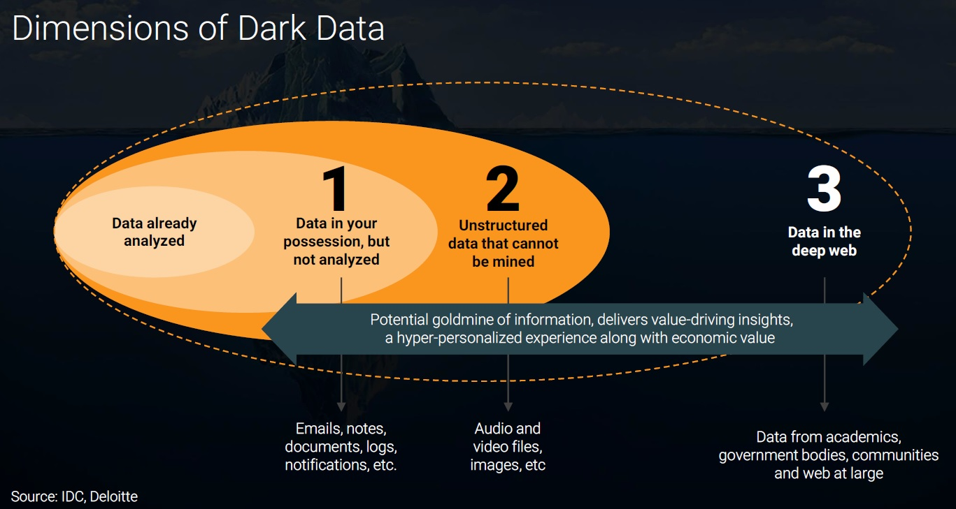
Notes:
Dark data makes up the huge majority of all data in every company, and they are a an importential goldmine of information just waiting to be extracted and put to use.

Slide 14
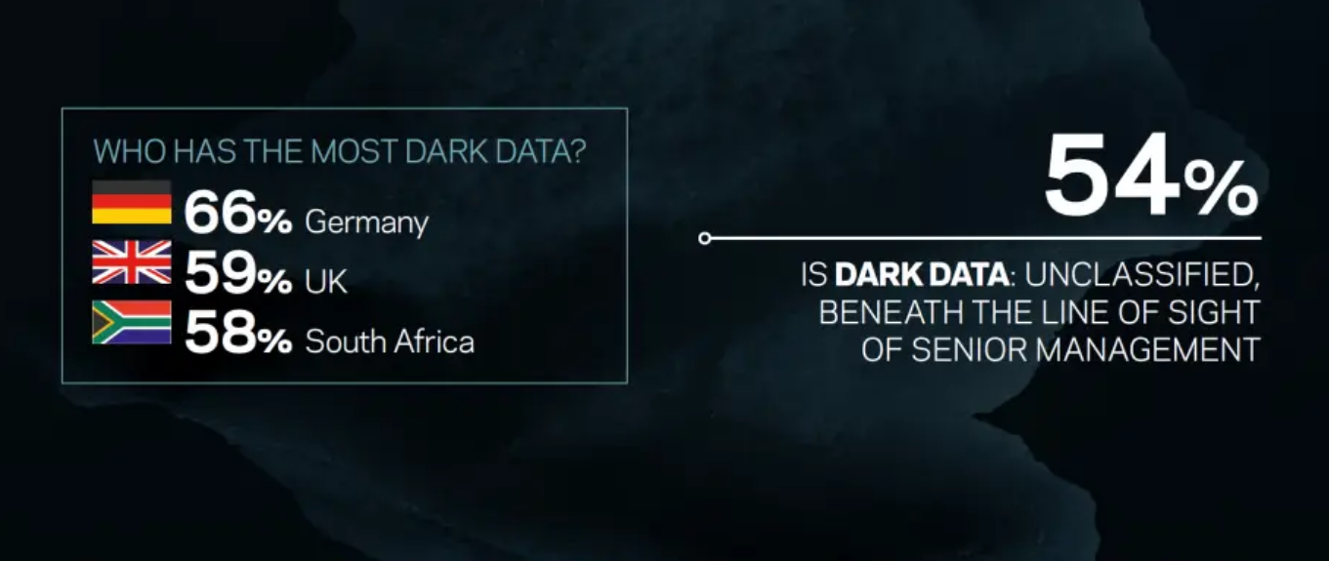
Source: Veritas Databerg Report
Notes:
Some countries are slower than others in realizing just what a treasure chest of data they are sitting on. Sadly, Germany and Austria are generally pretty bad at this, and this is increasingly proving to be a barrier for the adoption of digitization and AI in these countries.

Slide 15
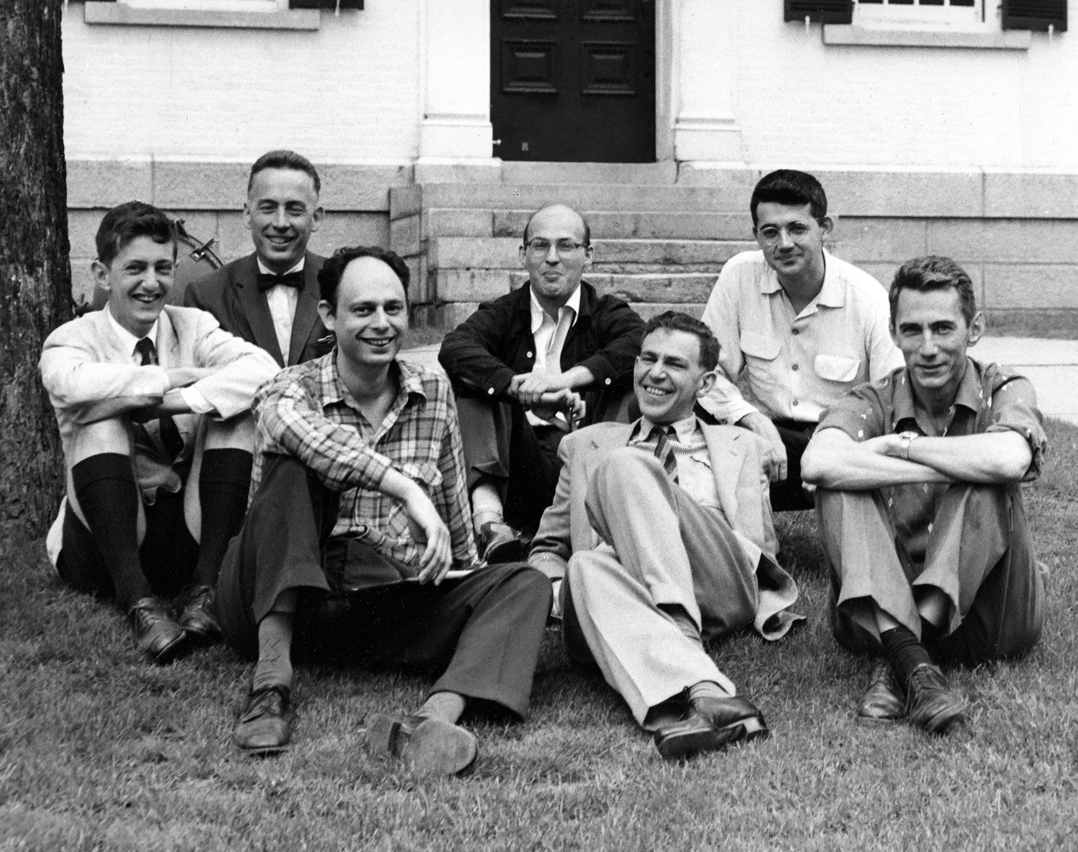
Notes:
Of course, AI itself isn’t really new. In fact, it began back in 1956, at Dartmouth College in New Hampshire, where almost all the leading researchers in the new field of so-called cognitive science gathered for an academic summer camp. They included such luminaries as John McCarthy of Stanford (in the plaid shirt), who invented the term "artificial intelligence," and Marvin Lee Minsky (far left in the knickerbockers), who would later found the AI Laboratory at MIT.

Slide 16

Notes:
The Dartmouth workshop, while producing significant breakthroughs in the understanding of AI, sadly also became the first example of the unprecedented hype that was to accompany it ever since.
Back in the summer of ‘56, some predicted that within just one generation, so in about 20 to 25 years, there would be machines that would be as intelligent as humans.
Well, as we now know, it was to take almost 40 years, namely until 1997, before IBM's supercomputer Deep Blue would defeat the reigning chess world champion Garry Kasparov and thus claim the title. But this did not stop the AI pioneers from loudly promoting their field of expertise.

Slide 17
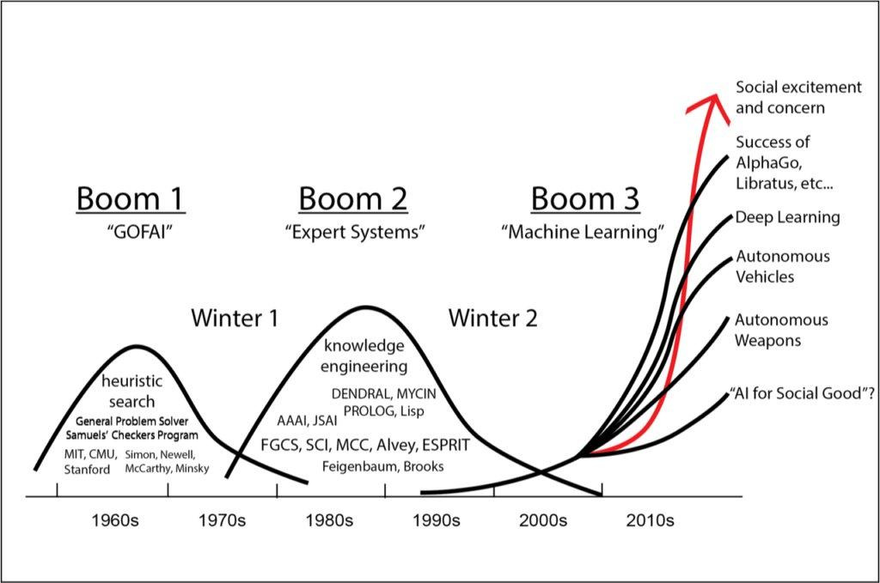
Source: Jonathan H Chen, Stanford U
Notes:
The result was a series of “AI Winters” in which disillusionment was rampant and investments fell off dramatically. Thousands of scientists lost their jobs and migrated to other disciplines or to the private sector.
Today, AI is finally poised to fulfill its premature promises and really drive a revolution in everything from manufacturing to R&D, planning, sales, customer service, HR, you name it.

Slide 18
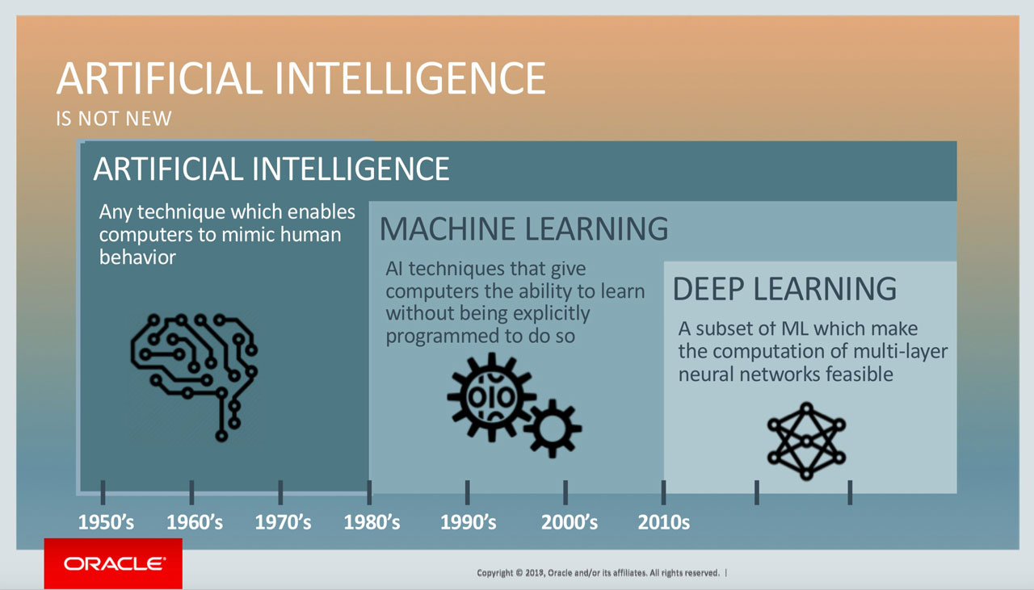
Notes:
AI has continued to make huge advances, from simple pattern recognition - which BTW is still an important application of AI in business, as we will see - to machine learning, namely self-learning computer systems, to Deep Learning, which enables computers maybe not really to think for themselves, but at least to convincingly mimic the functions of the human brain.

Slide 19
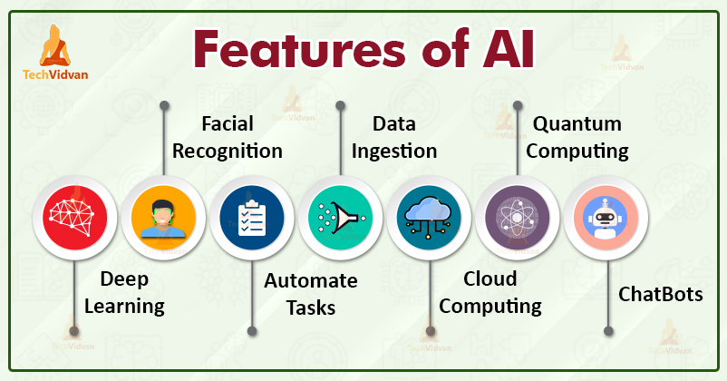
Notes:
I need to warn you, though: Don’t expect too much from artificial intelligence - but not too little either! Properly understood and applied, AI can radically transform our economy, our commerce, how we make things, how we communicate with our customers, and pretty much everything else.

Slide 20
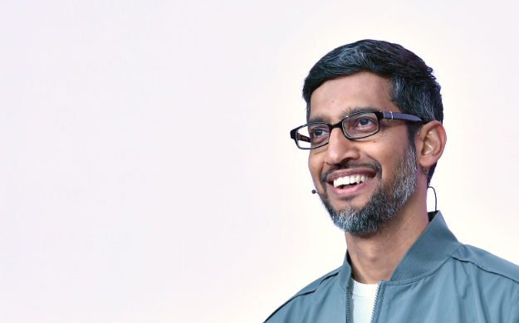
Sundar Pichai
Notes:
At the World Economic Forum 2018 in Davos, Google's CEO Sundar Pichai said, “AI will play a bigger role for humanity than the taming of fire or electricity.”

Slide 21
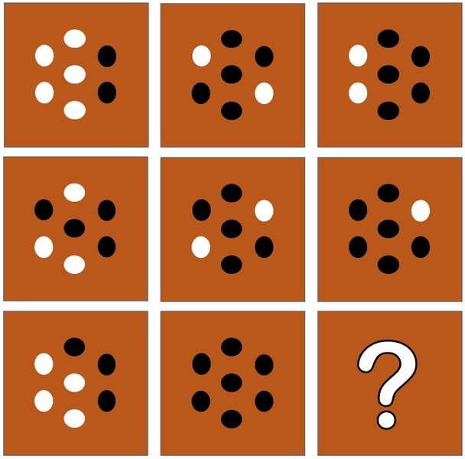
Notes:
But back to pattern recognition. Computers are much better at this than we humans are, and we can use this ability in manufacturing, for instance.

Slide 22
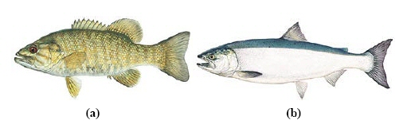
Notes:
One of my favorite examples is canned fish. Suppose the operator of a deep-sea fishery wants to build a system that helps him distinguish between sea bass (a) and pollock (b) and separate them before they are processed. He might install a camera and record such classes of information as the length of the fish - sea bass are usually slightly longer than pollock - or their width, the number and shape of their fins, or the color and luminosity of their scales. This information is fed into a computer that is linked to a sorting robot that distributes the fish to two different conveyor belts.

Slide 23


Notes:
Inevitably, mistakes will be made, and a few sea bass will end up with the pollock. But that’s bad for the operator because most people think that pollock tastes better than sea bass. Therefore, they are willing to pay more for pure pollock.
So the programmer will introduce certain limits: A fish below a certain length, say, will be sorted out, as will those in which the brightness of the scales exceeds or falls below a certain value.
However, the system must also take into account the lighting at the location where the picture was taken. The number of information classes and the complexity of the decision-making processes quickly rise to the astronomical - and with them the costs for the operator.

Slide 24
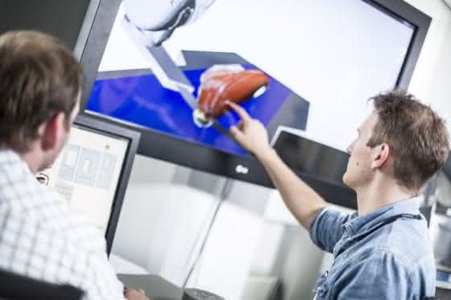
Notes:
Up to this point, we have assumed that the consequences of a wrong decision are always the same: It is just as undesirable for pollock to get into a can of sea bass meat as vice versa. But the operator knows from experience that customers are more forgiving if they find a piece of pollock in their can of sea bass. He can adjust the limits for certain classes so that the amount of pollock in the sea bass cans goes up a bit, but the costs go down. At the same time, the plant can work faster because it literally doesn't have to look as closely!

Slide 25

Notes:
The operator can therefore produce more cans of fish at less cost, and his company operates more profitably overall.

Slide 26
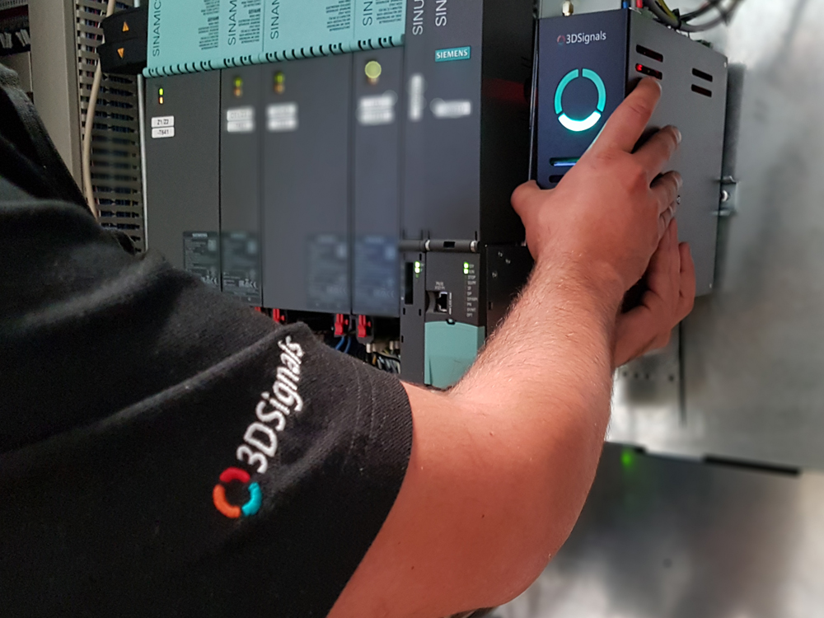
Notes:
Pattern recognition may be an old hat, but it is more important than ever in manufacturing today. After all, you can compare more than simply pictures. How about sound?
3DSignals, an Isreali startup, has a system it calls Predisound which consists of a number of ultrasonic sensors that can detect slight variations in the sound pattern of heavy machines or commercial vehicles to tell if a failure is about to occur.
Samson AG in Frankfurt, a leading manufcaturer of control valve technology, has been using Preisound for more than year, and CEO Dr. Andreas Widel claims his company has been able to increase machine productivity by a whopping 30%!

Slide 27
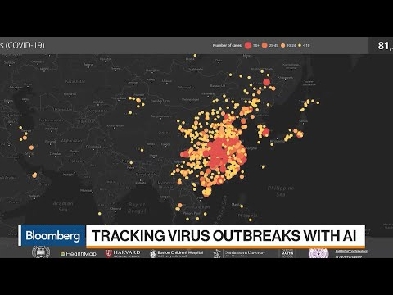
Notes:
So far, the discussion about AI has mostly focused on dystopian future scenarios and less on how AI will transform and improve the economy and the lives of millions of people. That's a shame, because AI can be a real boon for businesses.
Thanks to the analysis of vast amounts of data, the application of complex mathematical models, and the use of self-learning systems, AI researchers can look deep into the future, for example, to identify trade trends or to track and predict the spread of epidemics worldwide, which can not only save hundreds of thousands of lives but also protect us from a repeat of the 2020/21 economic crisis triggered by COVID-19.

Slide 28

Notes:
Thanks to predictive analysis of machine data, companies can protect themselves against failures and downtime in production and detect production errors before they occur - bringing the vision of "zero defect manufacturing" within reach.

Slide 29
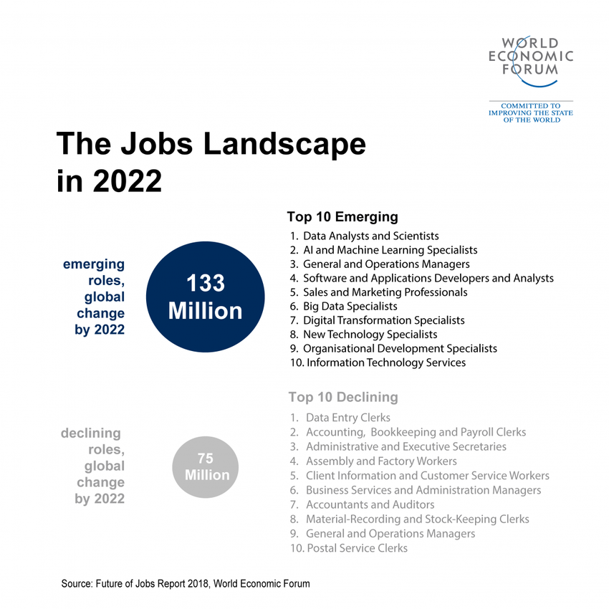
Notes:
Automation will cover more and more industries and areas in which human labor was previously a prerequisite. In return, it will create millions of new jobs where machine intelligence has reached its limits. In its study The Future of Jobs, the World Economic Forum predicts that AI will destroy around 75 million jobs by 2022, but create more than 133 million new jobs.
Speech recognition and voice control, predictive analysis, "learning" robots, facial recognition, autonomous vehicles and intelligent value creation processes are creating new opportunities for companies to take their productivity and competitiveness to a whole new level.

Slide 30
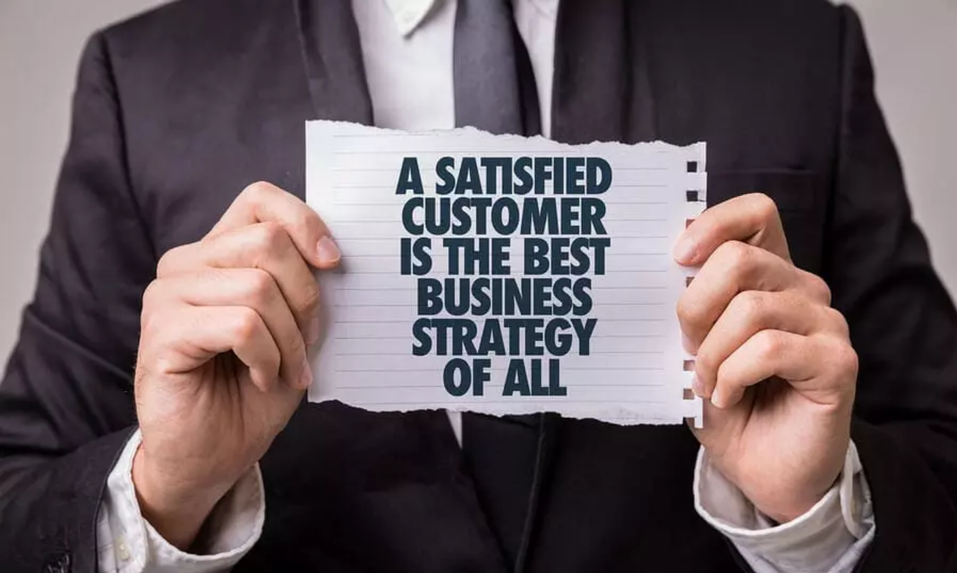
Notes:
AI is the enabler to create three things in particular that will be critical for tomorrow's business.
First, satisfied customers: Thanks to AI, companies can learn to understand their customers better. Based on this new knowledge of the customer, they can better predict market trends and better respond to the individual wishes and needs. This leads to more satisfied customers - and satisfied customers, as every manager knows, are the best customers.

Slide 31

Notes:
Second, smarter products and services: Gadgets and devices today need to become "smarter" if customers are to accept them. This applies to the latest generation of cell phones (which are not called "smartphones" for nothing) just as it does to cars, heating systems, kitchen appliances, televisions or entire homes (the keyword here is: "smart home").

Slide 32
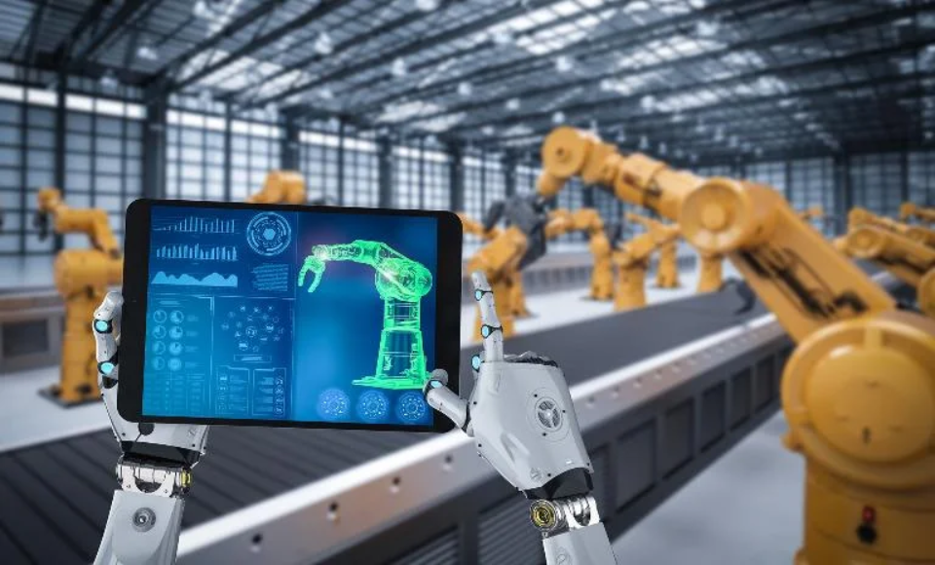
Notes:
And finally, autonomous manufacturing: An automation revolution is brewing in industrial production thanks to AI. From autonomous drones to self-controlling delivery robots, to self-learning production machines, AI is opening up previously unimaginable potential on the production line and in the supply chain, making "old" industries faster, more flexible and more competitive. The term to remember here is "Robot Process Automation", or RPA for short.

Slide 33
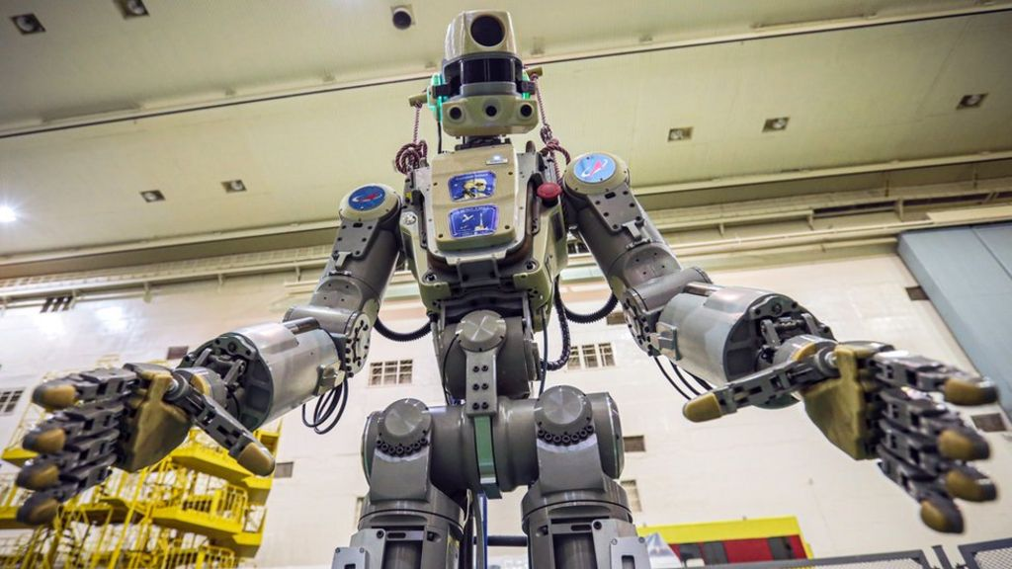
Notes:
And please don't be confused by the word "robot". RPA is not about more or less human-like machines. Rather, RPA is about software tools that take on manual, rule-based and mostly mind-numbing tasks - jobs that humans don't like to do anyway.

Slide 34
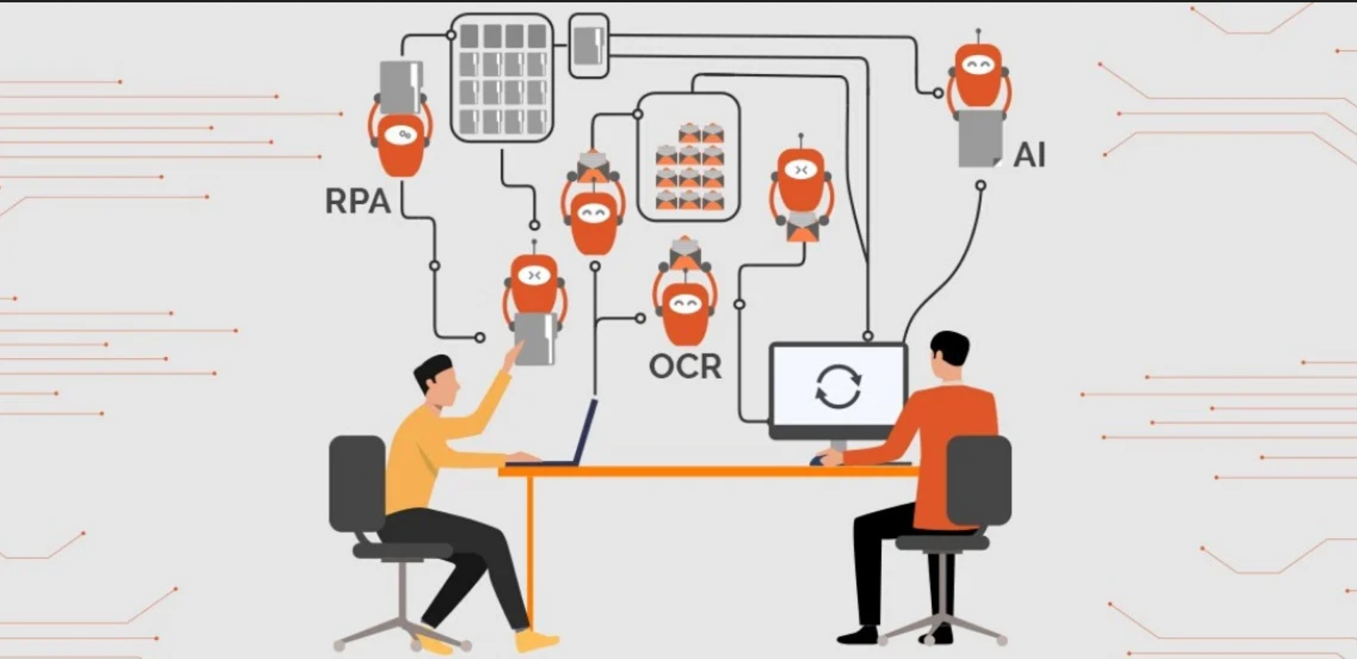
Notes:
Also known as Enterprise RPA, or ERPA, these tools can recognize and create logical paths enabling them to model a wider range of processes, collect necessary data, and use other tools and systems much like a human would. ERPA provides such helpful features as security and even audit trails.

Slide 35
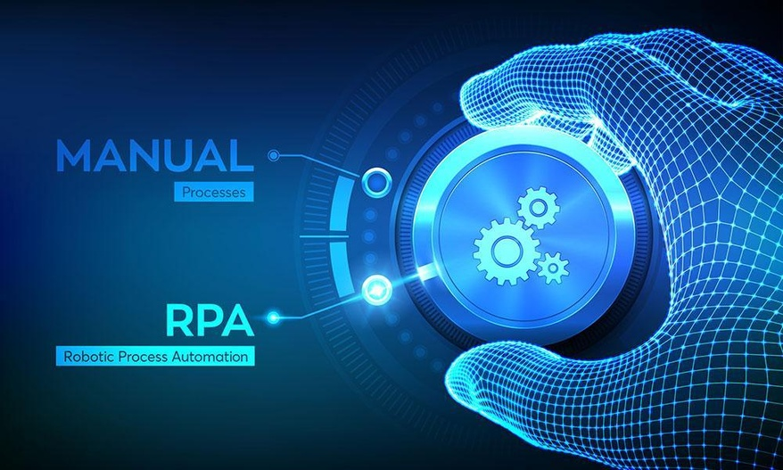
Notes:
But manual systems, too, are built on rules, even if they only exist in the minds of the workers and are not formally documented. Virtual robots, also known as robo-bots, can automatically take over a specific process, often working hand in hand with existing business process automation systems and human operators.

Slide 36
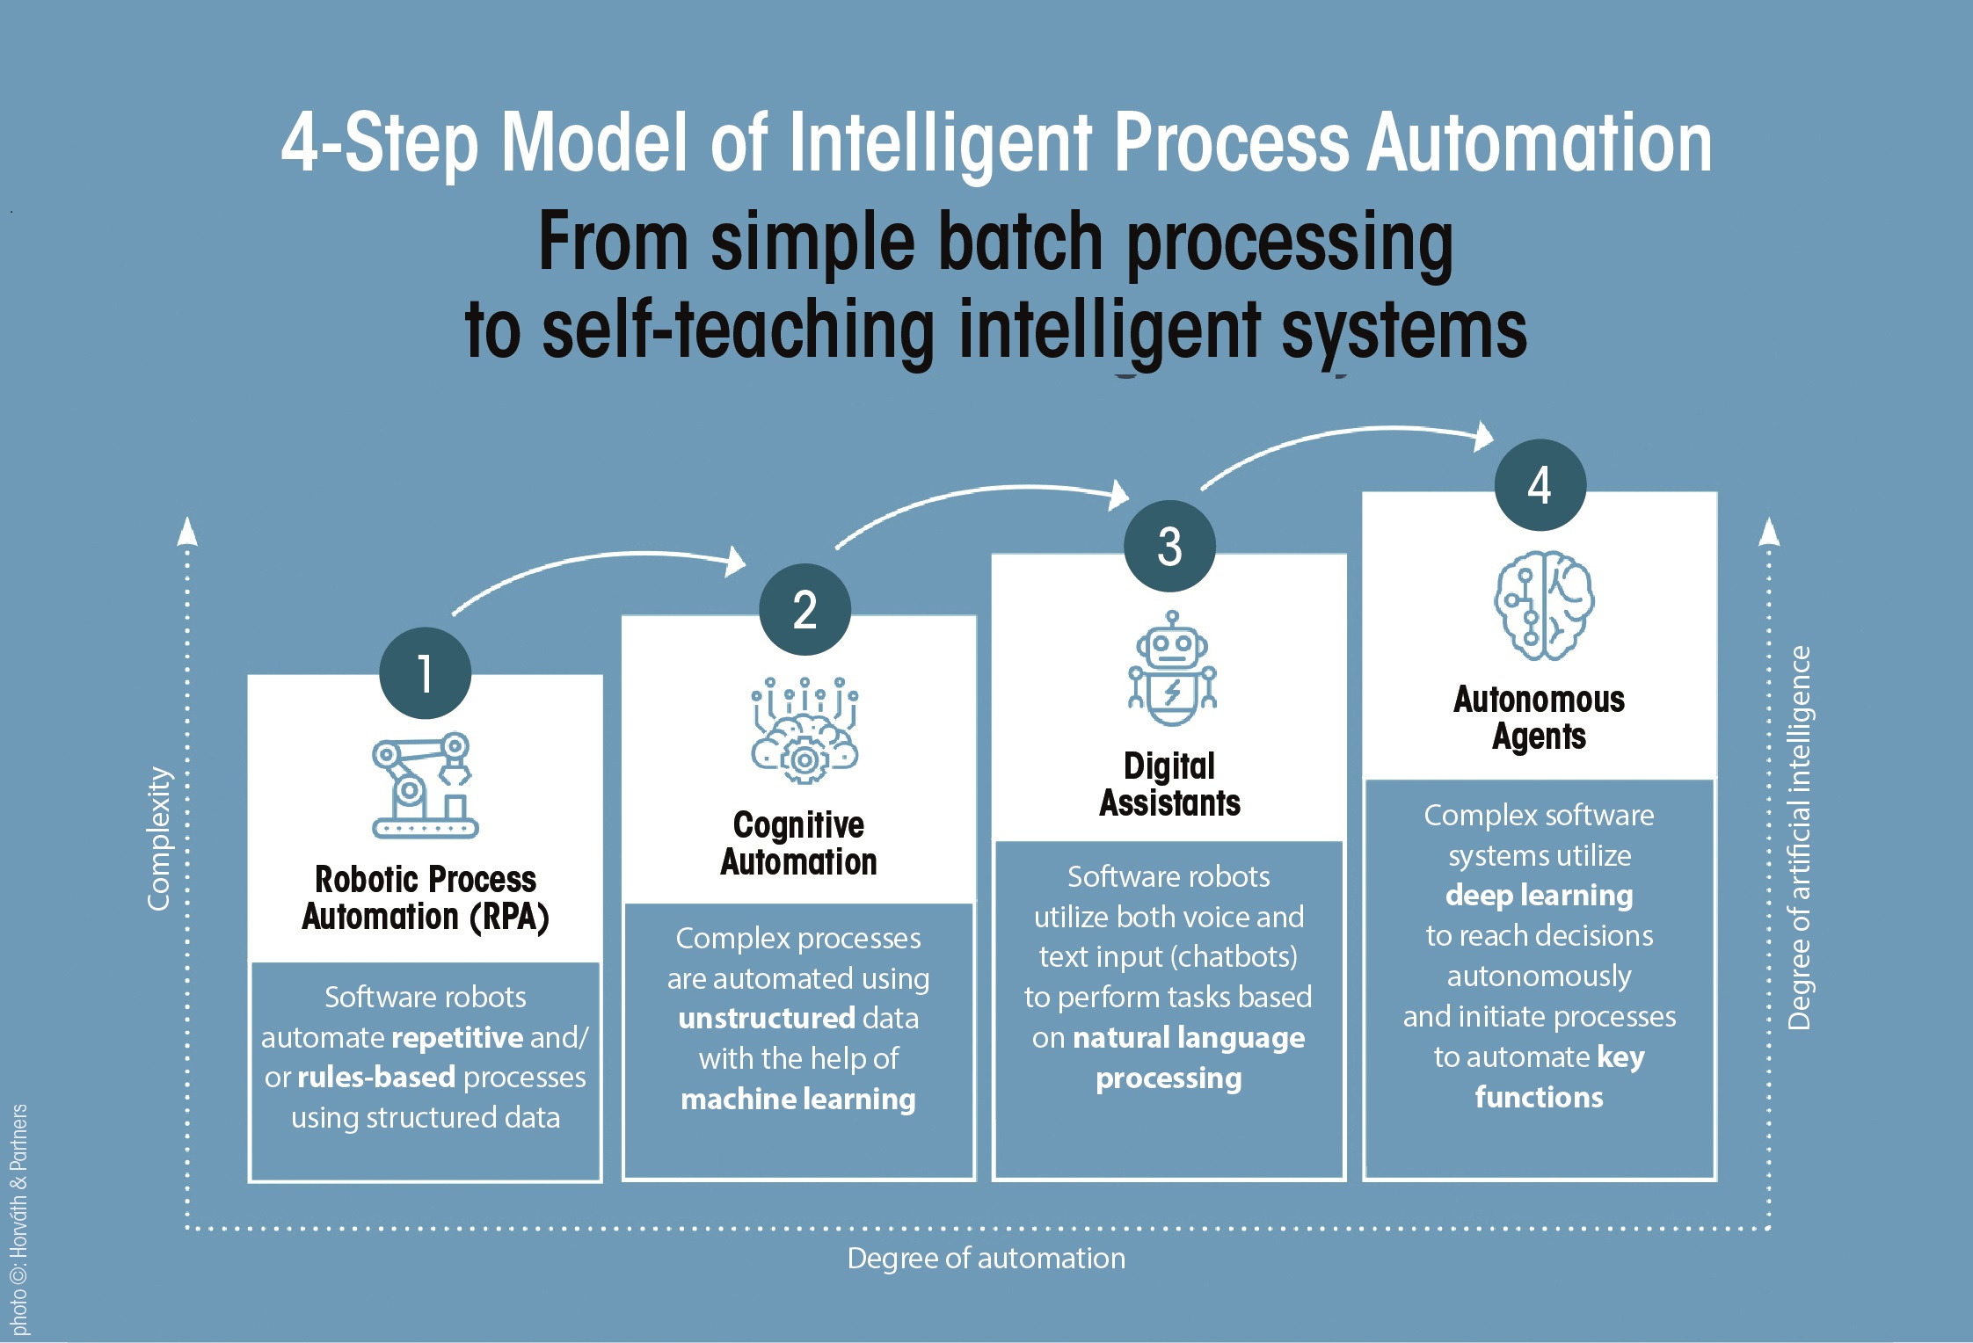
Notes:
According to the "Next Generation Process" study conducted by the consultants at Horváth & Partners, the introduction of RPA is usually based on a four-step model.

Slide 37
Notes:
It starts with simple automation by means of real robots - an important technology, because the large number of routine processes that can be automated by using them.
RPA software carries out recurring tasks according to clearly defined rules and checks the reliably of data.

Slide 38
Notes:
It is only in the second stage that the software gets by without predefined processing rules and learns to structure and process rules on its own. Such systems, also known as cognitive automation, can "read" archived documents or e-mails and categorize unstructured data volumes using digital data training. The more data the software organizes and processes, using machine learning, the faster and more effective the system becomes.

Slide 39
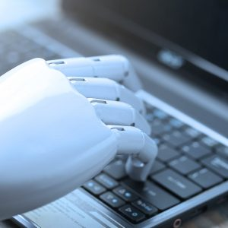
Notes:
Cognitive Process Automation offers companies the opportunity to extend automation to complex processes characterized by growing volumes of unstructured information. It can thus understand and derive user behavior from data patterns. It is also capable of automatically recognizing changing framework conditions and adapting the algorithm accordingly - in other words, "learning".

Slide 40
Notes:
Most companies lack experience with the third stage of automation which involves the use of digital assistants. But they are curious: Only 29 percent of the companies surveyed by Horváth & Partners have worked with Digital Assistants before, but 75 percent intend to do so soon. Digital assistants recognize spoken and written language and can understand the information contained in it. They extract relevant data, process it further and act as a link between people and the system. Think “Alexia for the shopfloor”.
Over time, the assistants learn to independently detect anomalies in the data and can proactively inform their human masters. Cognitive RPA systems can also include advanced analysis and machine learning. They adapt to new circumstances; a crucial difference compared to many traditional IT solutions, which often need to be completely reprogrammed before they can handle new tasks or situations.

Slide 41
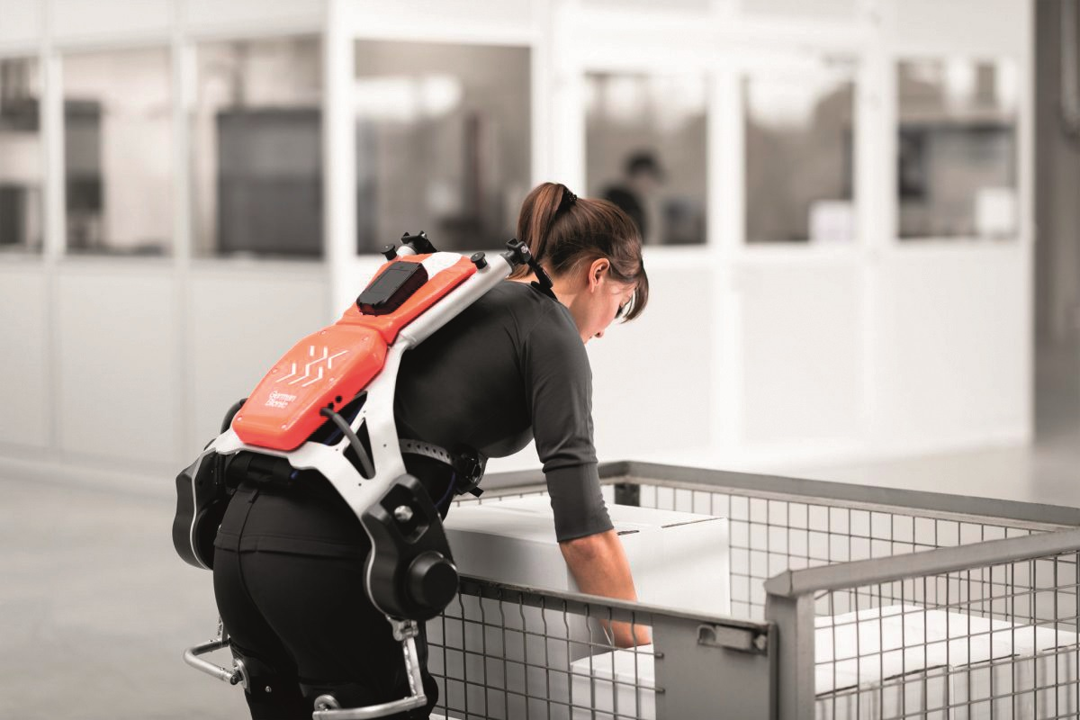
Notes:
Digital Assistants come in many sizes, shapes and forms. Their common goal is to enable humans, for instance by better synchronizing the delivery of parts and resources to the factory. Extoskeletons can be used wherever human labor cannot be sensibly replaced by full automation or robotic systems.

Slide 42
Notes:
The fourth and highest level of automation is reached when intelligent software can act independently and initiate processes. To date, most Western companies lack almost any experience with such so-called autonomous agent systems. These can make decisions without human intervention and control processes independently.
They can process huge masses of data very quickly, which will make them irreplaceable in the field of predictive analytics. Unfortunately, however, only two percent of companies surveyed already work with such autonomous systems, and another three percent have started testing. This will have to change for many companies if they want to remain internationally competitive in the long term.

Slide 43
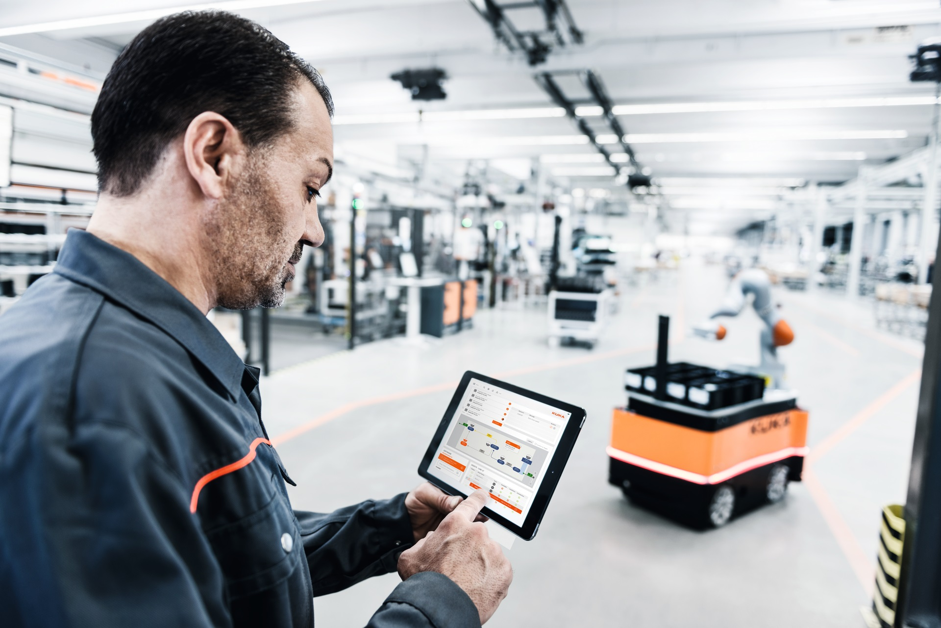
Notes:
Robots in factories are nothing new, of course. Traditionally, they work in specially designated areas behind protective fences so as not to endanger their human colleagues. They manufacture their workpieces as the programmers intended, without direct contact with humans.
A new generation of robots designed to work directly with humans are sometimes called „Cobots“. KUKA AG, a German robotics specialist now owned by the Chinese Midea Group, uses open interfaces to make cobots an integral part of IoT and Industry 4.0 environments.
To complement existing mechatronics systems, KUKA uses a cloud-based analysis and intelligence platform called KUKA Connect that harvests data through their fleet of cobots on the shopfloor and makes it accessible anytime, anywhere from any device. This, they believe, points towards a future of robot-centric AI and industry solutions aimed at creating the factory of tomorrow.

Slide 44
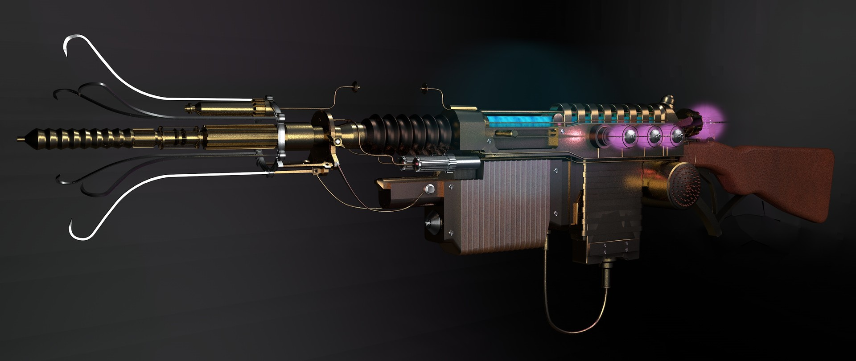
Notes:
But let‘s be honest here. RPA is not a miracle weapon and it can’t solve every business challenge. It is also more complex and requires a greater investment of time and talent than typical packaged software, for example. The interactions between bots and cobots must also be anticipated and understood. Perhaps that's why so many RPA adopters are large enterprises, where the necessary resources and prior technical knowledge exist.

Slide 45
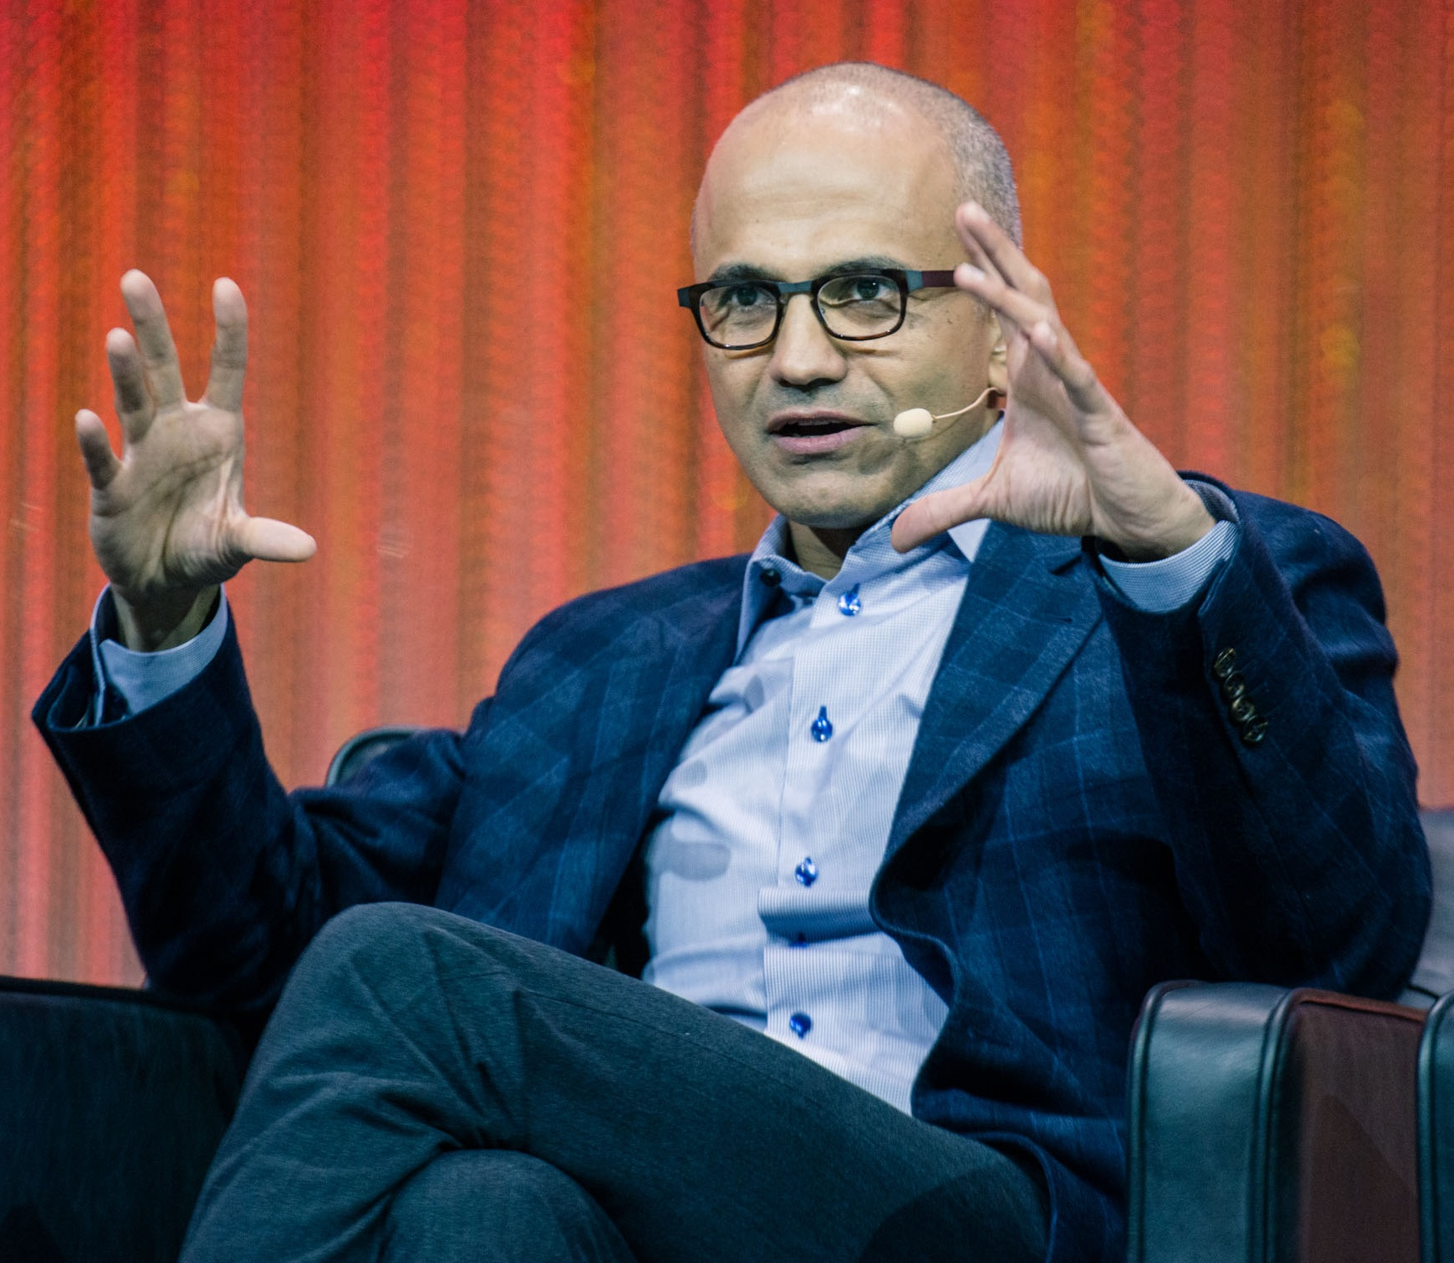
Notes:
However, smaller companies can also benefit from the advantages. There are increasing signs that Microsoft, for example, is planning to add an RPA module to its Dynamics ERP system, which is particularly popular with medium-sized companies. At a recent analyst briefing, CEO Satya Nadella said, "Our platform will combine robotic process automation with self-service, analytics and no-code development, enabling our customers to create a more data-centric culture."

Slide 46

Notes:
It will be interesting to see what will happen if other software giants like Oracle and SAP jump on the bandwagon and take over smaller RPA providers, especially when it comes to the protection of core business processes, where security is both important and, sadly, often neglected by some smaller vendors and their clients. Integration vs. Build-your-own could become a key issue here.

Slide 47
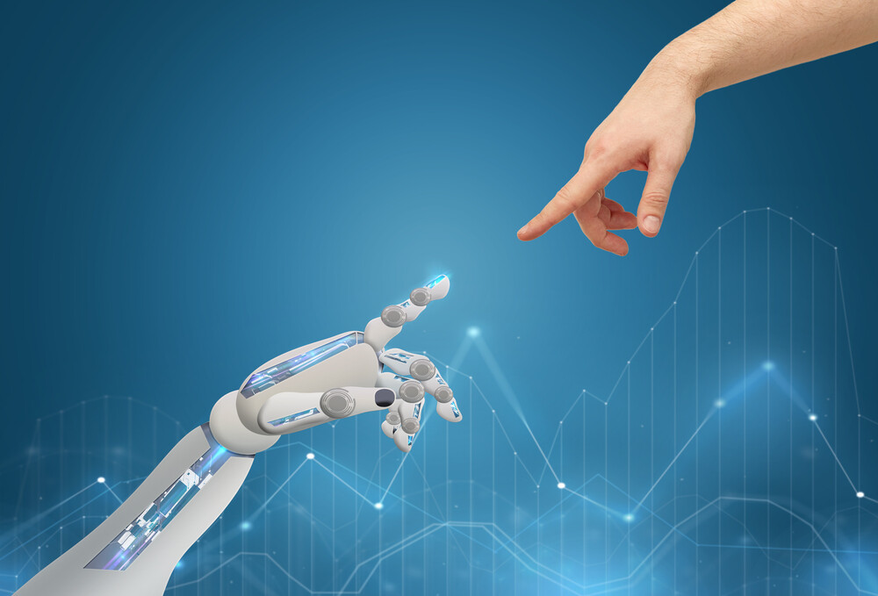
Notes:
Whichever way it turns out, it‘s clear that AI is finally awakening from it‘s winter hibernation and heading for a glorious season of new opportunities and growth.
AI may be just the logical next step in automation, the predictable outcome of Industry 4.0, but while AI will certainly be essential to the future of making, making the future will still require human ingenuity. There is no subsitute for an intelligent homo sapiens in dealing with unforeseen or unforeseeable circumstances – or in deciding what to make – or whether to make certain things at all.

Slide 48



Thank you!
Slides: www.cole.de
Mail: tim@cole.de
tc1066
@TCole1066
SuperTimCole

